Slide 1
Warm Up
Our track team has 56 students on it. There are 4 more girls than guys on the team. Determine how many girls and guys are on the team.
x
# of girls
x + y = 56
y
# of guys
y = x - 4
There are 30 girls and 26 boys on the track team.
Does that add up to 56? Is there 4 more girls than boys?
Notes:
Print the corresponding classwork sheet and work in groups

Slide 2
Applying Systems
Objective
DOL
SWBAT derive and solve a system of equations from a real-world scenario.
(2.4.d) (A-REI.6)
Given 1 CR problem, SW derive and solve a system of equations from a real-world scenario with 80% accuracy.
EQ: How can we use systems?

Slide 3
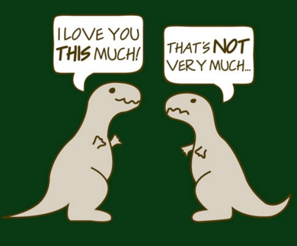
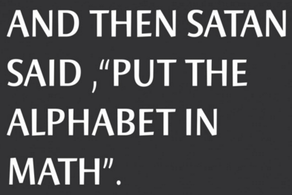
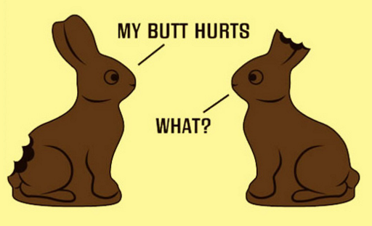
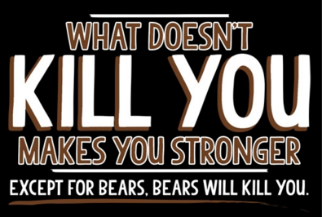
Pop Quiz
Which shirt design is best?

Slide 4
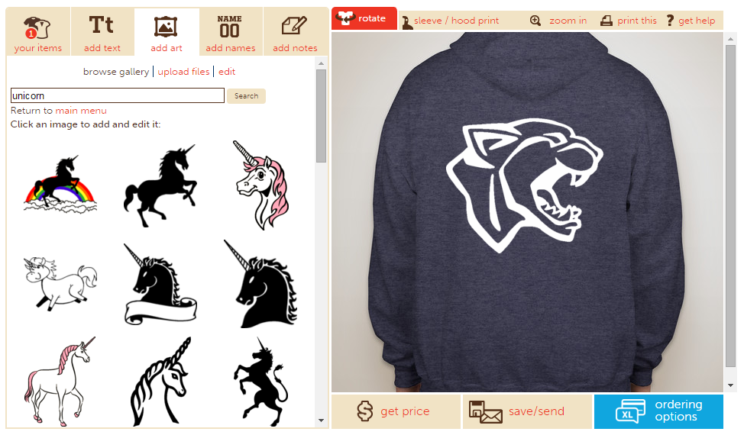
Custom Ink
Custom Ink lets anyone design clothes online.

Slide 5
Custom Ink
Today, we’ll design our project. You’ll:
Design a project
Price your shirt
Estimate your costs
See what it would take to turn a profit

Slide 6
Design Your Project
Choose a product (use the Products link)
Click “Start Designing” and customize your design
You can add text, use the art they provide, or bring in your own pictures

Slide 7
Pricing: Gallery Walk
On top of one whiteboard, write “I would pay…”. Leave that whiteboard with a marker on your desk.
Pull up your design on one laptop and put it next to the whiteboard. Close all other laptops.
Take 3 minutes to look at others’ designs.
For each design you look at, write what you would pay for it on their whiteboard. Do this for at least 5 designs.
Once you’re back at your table, average the prices to figure out what people would pay.

Slide 8
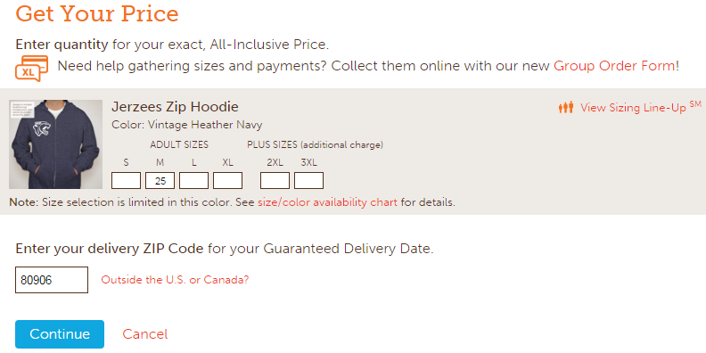
Estimate Your Costs
Click “Get Price”
Enter our zip code (80906)
Get two quotes.
For the first quote, enter 25 shirts.
For the second quote, enter 250 shirts.
Use these data points to create an equation to estimate your cost to produce any number of shirts

Slide 9
Profit Time
By now, you have your design. You know what it costs to make. You know what people are willing to pay. Let’s make our profit.
How much does it cost to make each shirt?
How many shirts do you need to sell to break even?
How much money would you lose if you sold zero shirts?
How many shirts would it take to make $1,000?
How much money would you make if you sold 500 shirts?

